Slide 1

AI COMP 469 · Introduction to Artificial Intelligence
CHAPTER 2
Sense
INTELLIGENT
AGENTS
Decide
This chapter builds the framework the rest of the course runs on: what an agent is, what makes its behavior rational, and how the task environment decides which agent design fits.
Act
IN THIS CHAPTER
Define agents: percepts, agent functions, agent programs
Core question: how should an agent choose actions in an environment?
Judge rationality against a stated performance measure
Russell & Norvig, AIMA 4e
Specify tasks with PEAS; classify task environments
Compare reflex, model-based, goal-based, utility-based agents
Add learning; choose atomic, factored, or structured state
AI COMP 469
CSU CHANNEL ISLANDS
Notes:
SLIDE 1 · Chapter 2 cover
Suggested time: 1 minutes · Running total: 1 min · Chapter alignment: Chapter opening
SOURCES
AIMA 4e, Chapter 2 (Intelligent Agents).
Objectives drawn from the deck roadmap on slide 5.

Slide 2
COMP 469
Chapter 2: Intelligent Agents
CSU Channel Islands · Department of Computer Science
Sense
Decide
Act
Core question: how should an agent choose actions in an environment?
Notes:
SLIDE 2 · Chapter 2: Intelligent Agents
Suggested time: 2 minutes · Running total: 3 min · Chapter alignment: Chapter introduction and Section 2.1
TRANSITION
We will begin with a quick capability question that reveals why the environment matters so much.
SOURCES
AIMA 4e, Chapter 2 introduction and Section 2.1.

Slide 3
What Can AI Do?
Warm-up
Reliable in formal worlds
Harder in open worlds
A better question to ask
Win at chess or Go
Translate speech
Classify images
Answer structured questions
Drive safely in all conditions
Unload any dishwasher in any home
Buy groceries in a physical store
Act with incomplete information
Do not ask only whether AI “can” do something. Ask what the environment is, what the agent can perceive, what actions are available, and how success is measured.
Task difficulty depends on environment structure.
Pick one task from each column and name the property that makes it easy or hard.
COMP 469 · Chapter 2
2
Notes:
SLIDE 3 · What Can AI Do?
Suggested time: 4 minutes · Running total: 7 min · Chapter alignment: Motivating task environments
TRANSITION
To evaluate these systems consistently, the course adopts the rational-agent perspective.
SOURCES
AIMA 4e, Chapter 2 introduction; lecture deck warm-up framing.

Slide 4
A Rational-Agent Perspective
Framing
Should we make machines that...
Think like people
Think rationally
human thought process
formal reasoning
Act like people
Act rationally
human-like behavior
choose effective actions
COMP 469 · Chapter 2
3
Notes:
SLIDE 4 · A Rational-Agent Perspective
Suggested time: 3 minutes · Running total: 10 min · Chapter alignment: Bridge from Chapter 1 to Chapter 2
TRANSITION
The roadmap shows how we move from this perspective to concrete agent designs.
SOURCES
AIMA 4e, Chapters 1 and 2.

Slide 5
2.0 Roadmap: From Agent Loop to Agent Design
Roadmap
Agent loop
Rationality
PEAS
percepts -> action
expected performance
task specification
Environment
Agent types
Representation
what makes it hard
table-driven -> learning
how the world is encoded
How the chapter builds: intuition -> formal model -> environment classification -> agent architecture -> demo.
COMP 469 · Chapter 2
4
Notes:
SLIDE 5 · 2.0 Roadmap: From Agent Loop to Agent Design
Suggested time: 2 minutes · Running total: 12 min · Chapter alignment: Lecture roadmap
TRANSITION
We will now define the perceive-act loop formally.
SOURCES
AIMA 4e, Chapter 2 structure.

Slide 6
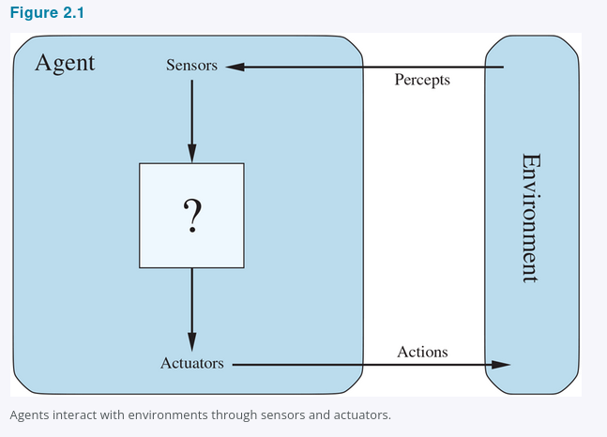
2.1 Agents and Environments: The Perceive-Act Loop
2.1
Examples of Actuators
Human: eyes/ears -> hands/voice
Robot: camera/lidar -> motors
Software: packets/input -> files/network
Figure 2.1
COMP 469 · Chapter 2
5
Notes:
SLIDE 6 · 2.1 Agents and Environments: The Perceive-Act Loop
Suggested time: 4 minutes · Running total: 16 min · Chapter alignment: Section 2.1
TRANSITION
To describe the agent's behavior precisely, we need the terms percept, percept sequence, agent function, and agent program.
SOURCES
AIMA 4e, Section 2.1 and Figure 2.1.

Slide 7
2.1 From Percepts to Agent Functions
2.1
Percept
Percept sequence
Agent function
Agent program
Current sensor content.
Example: current Pac-Man tile, nearby wall, visible ghost.
Complete history of everything the agent has perceived.
Abstract mapping:
percept sequence -> action
Concrete implementation running on an architecture.
percept sequence
action
Do not confuse these two:
Agent function = external mathematical description of behavior
Agent program = internal code that receives current percept and returns an action
Chapter 2 problem: produce rational behavior from a compact program, not a vast lookup table.
COMP 469 · Chapter 2
6
Notes:
SLIDE 7 · 2.1 From Percepts to Agent Functions
Suggested time: 4 minutes · Running total: 20 min · Chapter alignment: Section 2.1
TRANSITION
Now that behavior can be described, we need a standard for deciding whether the behavior is good.
SOURCES
AIMA 4e, Section 2.1.

Slide 8
2.1 The Vacuum World and Its Agent Function
2.1
Figure 2.2 — Two squares, A and B
Figure 2.3 — Partial tabulation
Percept sequence
Action
A
B
[A, Clean]
Right
agent
[A, Dirty]
Suck
[B, Clean]
Left
dirt
[B, Dirty]
Suck
One agent function: if the current square is dirty, then Suck; otherwise move to the other square.
[A, Clean], [A, Clean]
Right
[A, Clean], [A, Dirty]
Suck
Percepts: which square, and whether it is dirty.
Actions: Left, Right, and Suck; NoOp is added in some variants. The agent starts in A.
⋮ ⋮
Fill the right-hand column differently and you have a different agent
Bound the percept sequence at length T and the table still needs |P| + |P|² + … + |P|ᵀ rows. The tabulation is an external description of behavior; the agent program is what we actually have to write.
Figures 2.2 and 2.3
COMP 469 · Chapter 2
7
Notes:
SLIDE 8 · 2.1 The Vacuum World and Its Agent Function
Suggested time: 4 minutes · Running total: 24 min · Chapter alignment: Section 2.1, Figures 2.2 and 2.3
TRANSITION
To say which column is the right one, we need a standard for judging behaviour.
SOURCES
AIMA 4e, Section 2.1, Figures 2.2 and 2.3.

Slide 9
2.2 Good Behavior: Rationality Is Expected Performance
2.2
A rational agent selects the action expected to maximize its performance measure.
Performance measure
Prior knowledge
What counts as success?
What does the agent already know?
Available actions
Percept sequence
What can the agent actually do?
What evidence has it observed?
Rationality is not hindsight perfection. It uses evidence available at the time.
COMP 469 · Chapter 2
8
Notes:
SLIDE 9 · 2.2 Good Behavior: Rationality Is Expected Performance
Suggested time: 5 minutes · Running total: 29 min · Chapter alignment: Sections 2.2.1 and 2.2.2
TRANSITION
Because rational agents optimize what we specify, the design of the performance measure is critical.
SOURCES
AIMA 4e, Sections 2.2.1 and 2.2.2.

Slide 10
2.2 Rational? Only Under Stated Assumptions
2.2
What makes this agent rational
Change one line and it is irrational
Performance: one point for each clean square at each time step, over a lifetime of 1000 steps.
The geography is known in advance, but the dirt distribution and the starting square are not.
Clean squares stay clean; Suck cleans the current square; moving into a wall leaves the agent where it is.
The only actions are Right, Left, and Suck, and the agent perceives its location and dirt status correctly.
Penalize each movement: once the floor is clean the agent oscillates forever and bleeds points. Add NoOp and stopping becomes the rational choice.
Let clean squares become dirty again: it must go back and re-check them periodically.
Hide the geography: it now has to explore before it can clean efficiently.
Remove the location sensor: [Clean] no longer tells it whether to go Left or Right.
Rationality is a relation, not a property of the program
The same four lines of code are rational under the left column and irrational under the right. Nothing about the code changed — the performance measure, the prior knowledge, the action set, or the percepts did.
Exercise 2.VACR asks you to design agents for each of these variants.
COMP 469 · Chapter 2
9
Notes:
SLIDE 10 · 2.2 Rational? Only Under Stated Assumptions
Suggested time: 5 minutes · Running total: 34 min · Chapter alignment: Section 2.2.2
TRANSITION
Because rational agents optimize exactly what we specify, the design of the performance measure deserves its own scrutiny.
SOURCES
AIMA 4e, Section 2.2.2; Exercise 2.VACR.

Slide 11
2.2 Performance Measures: Be Careful What You Ask For
2.2
Bad measure
Better measure
Reward the vacuum for amount of dirt cleaned.
Failure mode: dump dirt, clean it, dump it again.
Reward clean squares over time.
Measure the environment outcome, not the agent’s visible effort.
General lesson
Design performance measures according to what you actually want achieved in the environment.
Connection to Chapter 1: wrong objectives create the King Midas / value-alignment problem.
COMP 469 · Chapter 2
10
Notes:
SLIDE 11 · 2.2 Performance Measures: Be Careful What You Ask For
Suggested time: 4 minutes · Running total: 38 min · Chapter alignment: Section 2.2.1
TRANSITION
A well-designed objective is necessary, but rationality still does not require perfect knowledge of the future.
SOURCES
AIMA 4e, Section 2.2.1; Chapter 1 value-alignment discussion.

Slide 12
2.2.1 Consequentialism and the Trouble with Averages
2.2.1
Consequentialism
Moral philosophy offers several accounts of the right thing to do. AI has largely adopted one: judge an agent by its consequences. Actions drive the environment through a sequence of states, and the performance measure scores that sequence.
Agent A — steady mediocrity
Agent B — bursts and long breaks
Cleans at a moderate level, continuously, for the whole shift. Never impressive, never absent.
Cleans energetically, then rests for long stretches. Spectacular in bursts, absent in between.
Identical average cleanliness. Which one do you want?
A reckless life of highs and lows, or a safe but humdrum existence? An economy where everyone lives in moderate poverty, or one where some live in plenty and others very poorly? An average hides the question rather than answering it.
And the measure itself may be unknown. One piece of software ships to many users, and we cannot anticipate each one's preferences. That argues for agents that stay uncertain about the true objective and learn it over time (Chapters 16, 18, 22).
COMP 469 · Chapter 2
11
Notes:
SLIDE 12 · 2.2.1 Consequentialism and the Trouble with Averages
Suggested time: 4 minutes · Running total: 42 min · Chapter alignment: Section 2.2.1
SOURCES
AIMA 4e, Section 2.2.1.

Slide 13
2.2 Rationality Is Not Omniscience
2.2
Omniscience
Rationality
Autonomy
Knows the actual outcome of every action. Impossible in realistic environments.
Chooses the action with best expected performance from available evidence.
Learns from percepts rather than depending only on designer assumptions.
Look
Learn
Act
Improve
Information gathering is rational when better percepts improve later decisions.
COMP 469 · Chapter 2
12
Notes:
SLIDE 13 · 2.2 Rationality Is Not Omniscience
Suggested time: 5 minutes · Running total: 47 min · Chapter alignment: Section 2.2.3
TRANSITION
To design such an agent, we must first specify the task environment completely enough to know what success and available interaction mean.
SOURCES
AIMA 4e, Section 2.2.3.

Slide 14
2.2.3 Three Cautionary Agents
2.2.3
The cargo door
The dung beetle
The sphex wasp
You see a friend across an empty street and start to cross. At 33,000 feet a cargo door falls off a passing airliner and flattens you. Your obituary will not read “Idiot attempts to cross street.”
It fetches a ball of dung to plug its nest. Take the ball away en route and it pantomimes the plugging anyway, never noticing the ball is gone. Evolution built the assumption in.
It drags a caterpillar to the burrow, steps inside to check, then drags it in. Nudge the caterpillar a few inches during the check and it restarts the drag step — dozens of times in a row.
Rationality maximizes expected performance; perfection maximizes actual performance.
No learning, so a violated assumption produces confidently wrong behavior.
It cannot notice that its own innate plan is failing, so it cannot change it.
Autonomy: learn enough to compensate for partial or wrong prior knowledge
Complete autonomy is rarely required from the start — an agent with no experience would have to act at random. Give it initial knowledge and the ability to learn, and after enough experience its behavior becomes effectively independent of what it was told at design time.
COMP 469 · Chapter 2
13
Notes:
SLIDE 14 · 2.2.3 Three Cautionary Agents
Suggested time: 5 minutes · Running total: 52 min · Chapter alignment: Section 2.2.3
TRANSITION
With rationality defined, we can specify the task an agent is meant to solve.
SOURCES
AIMA 4e, Section 2.2.3.

Slide 15
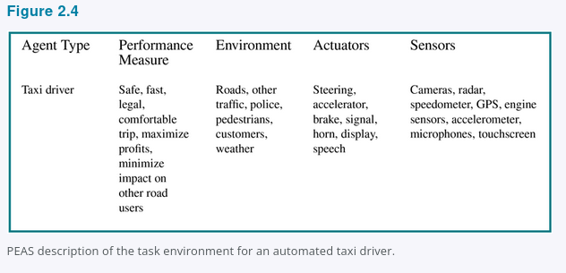
2.3.1 PEAS: Specify the Task Before Designing the Agent
2.3.1
PEAS = Performance measure, Environment, Actuators, Sensors
P
E
A
S
Performance
Environment
Actuators
Sensors
Safe, fast, legal, comfortable trip; minimize time/cost; maximize profit
Roads, traffic, pedestrians, weather, passengers, police, construction
Steering, accelerator, brake, signals, horn, display, speech
Cameras, lidar, radar, GPS, speedometer, engine sensors, voice/touch input
Design rule: specify the task environment as fully as possible first.
Figure 2.4
COMP 469 · Chapter 2
14
Notes:
SLIDE 15 · 2.3.1 PEAS: Specify the Task Before Designing the Agent
Suggested time: 6 minutes · Running total: 58 min · Chapter alignment: Section 2.3.1
TRANSITION
The next slide shows that the same PEAS structure applies to very different physical and software agents.
SOURCES
AIMA 4e, Section 2.3.1 and Figure 2.4.

Slide 16
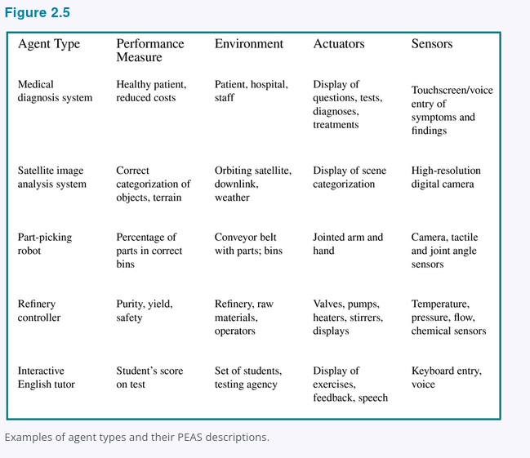
2.3.1 PEAS Examples: Agent Types and Task Environments
2.3.1
PEAS forces the designer to specify success, the world, available actions, and perceptual inputs before choosing an algorithm.
Design checkpoint: if PEAS is vague, the agent design will be vague.
Figure 2.5
COMP 469 · Chapter 2
15
Notes:
SLIDE 16 · 2.3.1 PEAS Examples: Agent Types and Task Environments
Suggested time: 6 minutes · Running total: 64 min · Chapter alignment: Section 2.3.1 and Figure 2.5
TRANSITION
Once the task is specified, the next step is to classify the environment along dimensions that determine the difficulty of agent design.
SOURCES
AIMA 4e, Section 2.3.1 and Figure 2.5.

Slide 17
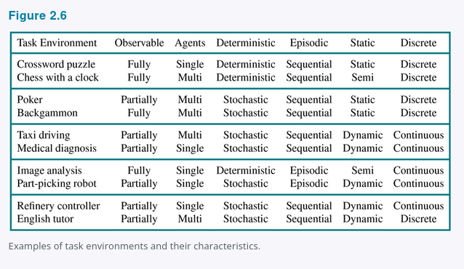
2.3.2 Task Environment Properties
2.3.2
Observable
Agents
Transition
Episodes
Fully <-> Partially
Single <-> Multi
Deterministic <-> Nondeterministic / stochastic
Episodic <-> Sequential
Time
State/action
Knowledge
Static <-> Dynamic / semidynamic
Discrete <-> Continuous
Known <-> Unknown
Hardest case: partially observable, multiagent, nondeterministic, sequential, dynamic, continuous, unknown.
Figure 2.6
COMP 469 · Chapter 2
16
Notes:
SLIDE 17 · 2.3.2 Task Environment Properties
Suggested time: 9 minutes · Running total: 73 min · Chapter alignment: Section 2.3.2
TRANSITION
Pac-Man gives us a compact environment in which many of these properties are visible at once.
SOURCES
AIMA 4e, Section 2.3.2 and Figure 2.6.

Slide 18
2.3.2 Reading the Fine Print on Three Dimensions
2.3.2
Nondeterministic vs. stochastic
Competitive vs. cooperative
Effectively fully observable
Both mean the next state is not guaranteed. The chapter reserves stochastic for models that quantify the uncertainty — “a 25% chance of rain.” Nondeterministic means the possibilities are listed without probabilities — “there is a chance of rain.”
Treat B as an agent when B's performance measure depends on A's behavior. In chess B's gain is A's loss, so it is competitive. For taxis, avoiding collisions raises everyone's score — cooperative, yet still competitive over one parking space.
Sensors need not capture the entire state, only everything relevant to the choice of action, and relevance depends on the performance measure. With no sensors at all the environment is unobservable — and goals may still be achievable (Chapter 4).
One more: semidynamic. The world holds still while you think, but your score does not. Chess with a clock. Crossword puzzles are simply static.
Classifying an environment is an argument you have to defend, not a label you look up. Expect to justify the one you pick.
COMP 469 · Chapter 2
17
Notes:
SLIDE 18 · 2.3.2 Reading the Fine Print on Three Dimensions
Suggested time: 5 minutes · Running total: 78 min · Chapter alignment: Section 2.3.2
TRANSITION
One pair of dimensions gets confused so often that it deserves its own slide.
SOURCES
AIMA 4e, Section 2.3.2.

Slide 19
2.3.2 Known Is Not the Same as Observable
2.3.2
Fully observable
Partially observable
Known
Chess
Solitaire
The rules are given and the whole board is in front of you.
You know the rules perfectly, but you cannot see the cards that have not been turned over.
Unknown
A new video game
A rental car abroad
The screen shows the entire game state, and you still have no idea what the buttons do until you press them.
Unfamiliar geography, different traffic laws, other drivers whose intentions you cannot see, and nervous passengers.
Known/unknown describes the designer's grip on the rules, not the sensors
In an unknown environment the agent has to learn how the world works before it can decide well. And as we saw, the performance measure itself can be unknown — which quietly turns the task into a multiagent one, with the user as the other agent.
COMP 469 · Chapter 2
18
Notes:
SLIDE 19 · 2.3.2 Known Is Not the Same as Observable
Suggested time: 4 minutes · Running total: 82 min · Chapter alignment: Section 2.3.2
TRANSITION
With the task specified and the environment classified, we can finally look inside the agent.
SOURCES
AIMA 4e, Section 2.3.2.

Slide 20
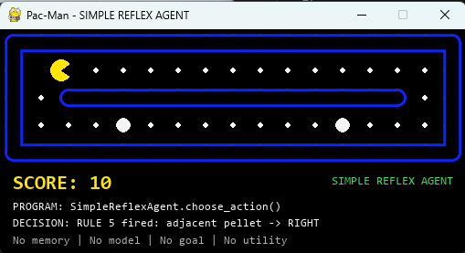
Pac-Man as a Chapter 2 Agent
Example
Sensors / percepts
Walls, pellets, ghost positions, legal moves, power-pellet status.
Actions / actuators
Move left, right, up, or down. Action changes the maze state.
Performance
Maximize score; eat pellets; avoid ghosts; use power pellets safely.
Environment
Sequential, multiagent, discrete, deterministic, known; dynamic in real-time play. Partially observable in richer versions.
In the class demo, the autonomous Pac-Man game implements this loop in code.
COMP 469 · Chapter 2
19
Notes:
SLIDE 20 · Pac-Man as a Chapter 2 Agent
Suggested time: 4 minutes · Running total: 86 min · Chapter alignment: Running example across Sections 2.1-2.4
TRANSITION
Before we move inside the agent, we will stress-test a simple reflex Pac-Man program in two maze levels and use its failures to motivate stronger designs.
SOURCES
AIMA 4e, Sections 2.1-2.4; lecture deck Pac-Man example.

Slide 21
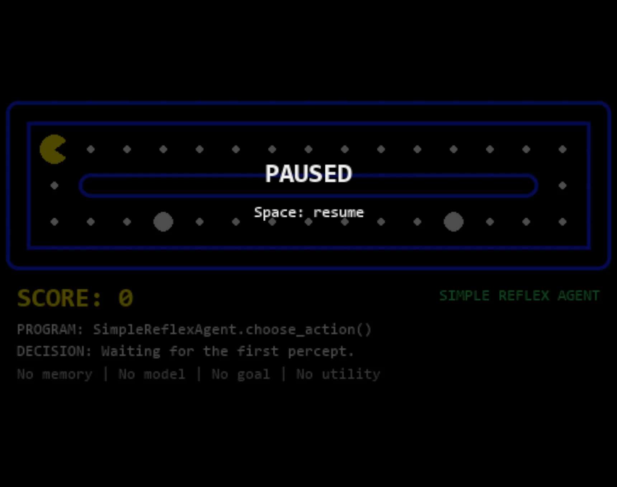
Pac-Man Simple Reflex Demo — Level 1
Notes:
SLIDE 21 · Pac-Man Simple Reflex Demo — Level 1
Suggested time: 3 minutes · Running total: 89 min · Chapter alignment: Section 2.4.2; simple reflex agents and motivation
TRANSITION
Level 2 keeps the same basic agent design but adds detours and branches, making the architectural limitation much harder to hide.
SOURCES
Embedded Pac-Man simple-reflex demonstration in this deck.
AIMA 4e, Section 2.4.2.

Slide 22

Pac-Man Simple Reflex Demo — Level 2
Notes:
SLIDE 22 · Pac-Man Simple Reflex Demo — Level 2
Suggested time: 4 minutes · Running total: 93 min · Chapter alignment: Section 2.4.2; limitations of simple reflex behavior
TRANSITION
The next slide separates the root architectural problem from the search algorithm that could be used inside a stronger agent.
SOURCES
Embedded Pac-Man simple-reflex demonstration in this deck.
AIMA 4e, Sections 2.3.2 and 2.4.2.

Slide 23
What breaks in Levels 1 and 2
The agent sees adjacent percepts only; it does not build a route to remaining food.
Level 1: simple corridor plus hidden lower route
Observed issue
What BFS would add
The rules eat adjacent pellets and then continue or pick the first legal action. Once food is not adjacent, the agent has no search frontier, no map of unvisited corridors, and no target.
BFS could expand reachable grid states from Pac-Man and return the shortest path to a selected pellet, including routes that initially move away from the pellet.
Level 2: detours and branches require planning
Why this is not a BFS failure
Remaining risk
Breadth-first search is never called in this script. The failure is caused by the Simple Reflex design: current percept -> ordered rule -> action.
Even with BFS, the agent still needs a state definition, a goal policy, and replanning when ghosts or pellets change. Otherwise BFS only solves the static shortest-path subproblem.
Root cause: no memory / no model / no goal
BFS adds route search, not intelligence by itself
COMP 469 · Chapter 2
22
Notes:
SLIDE 23 · What breaks in Levels 1 and 2
Suggested time: 5 minutes · Running total: 98 min · Chapter alignment: Sections 2.4.2 and 2.4.4; bridge from reflex behavior
TRANSITION
Even after we add BFS as a planner, several limitations remain, especially once the world becomes dynamic or the objective is richer than minimum number of moves.
SOURCES
AIMA 4e, Sections 2.4.2 and 2.4.4; search terminology used here as a
forward reference to the next unit.
Pac-Man demonstrations and analysis on this slide.

Slide 24
BFS helps with reachability, but it is still limited
Use BFS as a planner inside a model-based or goal-based agent, not as a replacement for the agent architecture.
Grid state
(position, walls, food)
Queue frontier
level by level
Visited set
avoids loops
Shortest path
if unweighted
Next action
returned to game
Limitation 1: static model assumption
Limitation 2: unweighted shortest path
Limitation 3: state explosion
Classic BFS assumes the graph is known while searching. Moving ghosts, frightened timers, and disappearing pellets require replanning after each action.
BFS optimizes number of moves, not risk, score, power-pellet timing, or ghost avoidance. Weighted objectives need UCS, A*, or utility-based planning.
A richer state such as position + pellets + ghost positions grows quickly. BFS can become memory-heavy before it becomes strategically useful.
Takeaway: Levels 1 and 2 show that a reflex rule set can look reasonable locally but fail globally. BFS fixes path finding only when paired with a map, a goal, and repeated replanning.
COMP 469 · Chapter 2
23
Notes:
SLIDE 24 · BFS helps with reachability, but it is still limited
Suggested time: 5 minutes · Running total: 103 min · Chapter alignment: Section 2.4.4; forward reference to search and
TRANSITION
With that motivation in place, we can now formalize what sits inside an agent: the architecture that provides capabilities and the program that maps percepts to actions.
SOURCES
AIMA 4e, Section 2.4.4; BFS details are a forward reference to the
search chapters.
Pac-Man demonstration analysis in this deck.

Slide 25
2.4 Agent Structure: Architecture + Program
2.4
agent = architecture + program
Agent function
Architecture
Agent program
Behavior implemented by the program: percept sequence -> action.
Physical or computational platform: sensors, processors, memory, actuators. The program must fit it — recommend walking and the architecture needs legs.
Software that receives percepts and returns actions.
Why not use a giant lookup table?
Too many percept sequences to store.
Too much work for the designer to fill in.
Too much experience for the agent to learn every entry.
AI problem: produce rational behavior from a compact program, not a vast table.
COMP 469 · Chapter 2
24
Notes:
SLIDE 25 · 2.4 Agent Structure: Architecture + Program
Suggested time: 4 minutes · Running total: 107 min · Chapter alignment: Sections 2.4 and 2.4.1
TRANSITION
The table-driven agent is our conceptual baseline for implementing an agent function.
SOURCES
AIMA 4e, Sections 2.4 and 2.4.1.

Slide 26
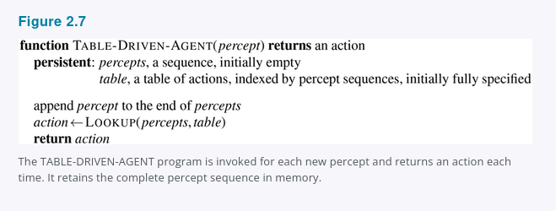
2.4.1 Table-Driven Agent
2.4.1
A table-driven agent stores the entire percept sequence and indexes a table of actions.
What it demonstrates
The agent function can be represented explicitly as a mapping from percept history to action.
Why it matters
It is correct in principle if the table is filled correctly, but it is usually infeasible.
Term to know
Table-driven agent: the simplest conceptual agent program in Section 2.4.1.
Figure 2.7
COMP 469 · Chapter 2
25
Notes:
SLIDE 26 · 2.4.1 Table-Driven Agent
Suggested time: 5 minutes · Running total: 112 min · Chapter alignment: Section 2.4.1 and Figure 2.7
TRANSITION
The next slide explains why this correct-in-principle design fails as an engineering solution.
SOURCES
AIMA 4e, Section 2.4.1 and Figure 2.7.

Slide 27
Why Table-Driven Agents Fail in Practice
2.4.1
The lookup table grows with every possible percept sequence.
Space problem
Design problem
Learning problem
No physical agent can store every entry for a realistic environment.
No designer can fill in the right action for every possible sequence.
No agent can experience every possible percept sequence.
Key challenge for AI
Write small programs that produce rational behavior without enumerating every possible history.
COMP 469 · Chapter 2
26
Notes:
SLIDE 27 · Why Table-Driven Agents Fail in Practice
Suggested time: 4 minutes · Running total: 116 min · Chapter alignment: Section 2.4.1
TRANSITION
The simplest compact alternative is a reflex agent that uses condition-action rules.
SOURCES
AIMA 4e, Section 2.4.1.

Slide 28
2.4.1 The Numbers Behind the Failure
2.4.1
70 MB/s
10⁶⁰⁰,⁰⁰⁰,⁰⁰⁰,⁰⁰⁰
10¹⁵⁰
< 10⁸⁰
Visual input from a single taxi camera at 30 fps, 1080 × 720, 24-bit color. Eight cameras is typical.
Entries the lookup table would need for one hour of driving from a single camera.
Entries for chess alone — a tiny, well-behaved fragment of the real world.
Atoms in the observable universe, for comparison.
Newton, not tables
Before the 1970s, engineers and schoolchildren looked up square roots in enormous printed tables. A five-line program for Newton's method on a pocket calculator replaced all of them. The chapter's wager is that AI can do the same for intelligent behavior generally.
No agent can store it, no designer can fill it in, no agent can learn it
TABLE-DRIVEN-AGENT is not wrong — filled in correctly it implements exactly the agent function we want. It is simply unbuildable. The key challenge is producing rational behavior from a small program instead.
COMP 469 · Chapter 2
27
Notes:
SLIDE 28 · 2.4.1 The Numbers Behind the Failure
Suggested time: 4 minutes · Running total: 120 min · Chapter alignment: Section 2.4.1
TRANSITION
The first and smallest such program is the simple reflex agent.
SOURCES
AIMA 4e, Section 2.4.1.

Slide 29
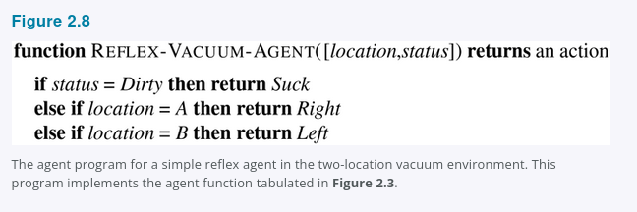
2.4.2 Simple Reflex Agents: Vacuum Pseudocode
2.4.2
Select an action from the current percept only.
Vacuum rule
if status = Dirty then Suck
else if location = A then Right
else if location = B then Left
Why this is reflex
The action depends only on current location and dirt status, not the entire percept history.
Strength: fast and compact. Weakness: brittle when the current percept is incomplete.
Figure 2.8
COMP 469 · Chapter 2
28
Notes:
SLIDE 29 · 2.4.2 Simple Reflex Agents: Vacuum Pseudocode
Suggested time: 5 minutes · Running total: 125 min · Chapter alignment: Section 2.4.2 and Figure 2.8
TRANSITION
A general simple reflex architecture separates percept interpretation from rule matching.
SOURCES
AIMA 4e, Section 2.4.2 and Figure 2.8.

Slide 30
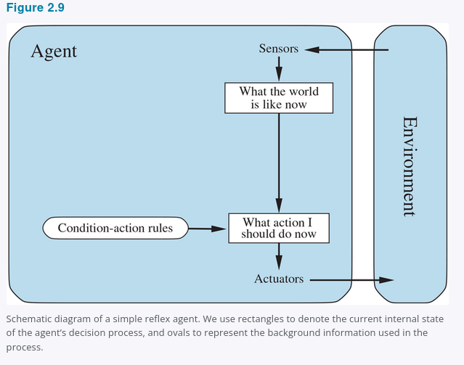
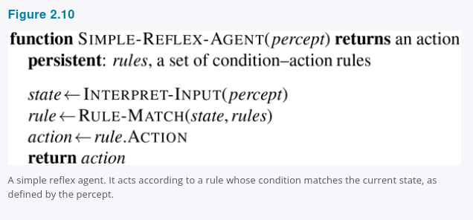
2.4.2 General Simple Reflex Agent
2.4.2
General pattern
Interpret current percept -> match condition-action rule -> return rule action.
Key limitation
If the current percept does not reveal enough state, the rule may choose the wrong action.
Figures 2.9 and 2.10
COMP 469 · Chapter 2
29
Notes:
SLIDE 30 · 2.4.2 General Simple Reflex Agent
Suggested time: 5 minutes · Running total: 130 min · Chapter alignment: Section 2.4.2 and Figures 2.9-2.10
TRANSITION
Partial observability exposes the central limitation of simple reflex behavior.
SOURCES
AIMA 4e, Section 2.4.2 and Figures 2.9-2.10.

Slide 31
2.4.2 Condition–Action Rules: Power and Limits
2.4.2
The rule behind the brake pedal
Compression: 4ᵀ → 4
if car-in-front-is-braking then initiate-braking
Ignoring percept history cuts the vacuum agent's relevant percept sequences from 4ᵀ down to just 4.
Why even this rule is fragile
It can be a circuit
It assumes the condition can be read off a single video frame. That works when the car ahead has a centrally mounted brake light.
Older vehicles arrange taillights, brake lights, and turn signals differently, and one image often cannot tell braking from lights simply being on.
A simple reflex agent behind such a car either brakes continuously and needlessly, or never brakes at all.
The rule set is simple enough to implement as Boolean logic gates — or as the nonlinear units of a neural network (Chapter 21).
Learned and innate
Braking on brake lights is learned; blinking when something nears the eye is not. Both are condition–action rules.
Randomizing helps: a coin flip reaches the other square in two steps on average
But that is a trick for escaping loops, not general intelligence. Randomized behavior can be rational in multiagent settings because it defeats predictability; in single-agent environments it usually is not.
COMP 469 · Chapter 2
30
Notes:
SLIDE 31 · 2.4.2 Condition--Action Rules: Power and Limits
Suggested time: 4 minutes · Running total: 134 min · Chapter alignment: Section 2.4.2
TRANSITION
The next slide works through the vacuum version of this failure in detail, and then we build the fix: an agent that keeps internal state.
SOURCES
AIMA 4e, Section 2.4.2.

Slide 32
When Simple Reflex Fails: Partial Observability
2.4.2
Problem
Vacuum example
Temporary fix
The current percept does not contain enough information to choose correctly.
If the agent sees only Clean/Dirty but not location, moving Left or Right can loop forever.
Randomization can sometimes escape loops, but it is not general intelligence.
Better solution: maintain internal state or use a model of the world.
percept
memory
model
action
COMP 469 · Chapter 2
31
Notes:
SLIDE 32 · When Simple Reflex Fails: Partial Observability
Suggested time: 4 minutes · Running total: 138 min · Chapter alignment: Section 2.4.2
TRANSITION
Model-based agents use internal state plus models of the world and sensors.
SOURCES
AIMA 4e, Section 2.4.2.

Slide 33
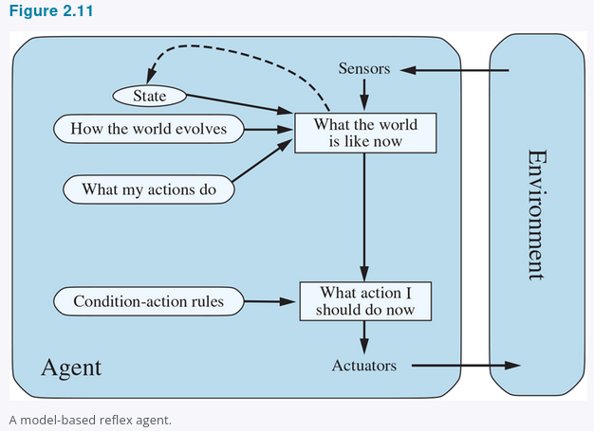
2.4.3 Model-Based Reflex Agents
2.4.3
Maintain internal state: a best guess about what the world is like now.
Transition model
How the world changes over time and how actions affect it.
Sensor model
How world states generate percepts.
Internal state
Tracks what is not evident in the current percept.
Figure 2.11
COMP 469 · Chapter 2
32
Notes:
SLIDE 33 · 2.4.3 Model-Based Reflex Agents
Suggested time: 6 minutes · Running total: 144 min · Chapter alignment: Section 2.4.3 and Figure 2.11
TRANSITION
The pseudocode shows exactly where state, action history, and models enter the decision loop.
SOURCES
AIMA 4e, Section 2.4.3 and Figure 2.11.

Slide 34
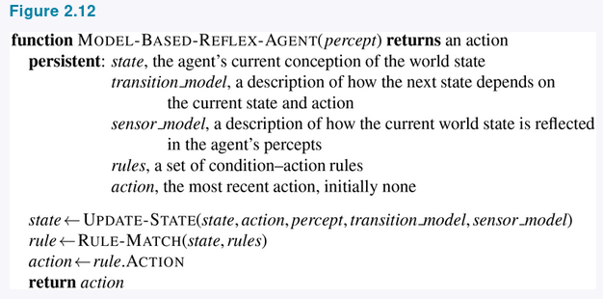
2.4.3 Model-Based Reflex Agent Pseudocode
2.4.3
The interesting step is UPDATE-STATE: combine old state, last action, current percept, transition model, and sensor model.
Partial observability means exact state may be impossible; the agent still must decide.
Figure 2.12
COMP 469 · Chapter 2
33
Notes:
SLIDE 34 · 2.4.3 Model-Based Reflex Agent Pseudocode
Suggested time: 6 minutes · Running total: 150 min · Chapter alignment: Section 2.4.3 and Figure 2.12
TRANSITION
Internal state tells the agent where it believes it is; a goal tells the agent where it wants to go.
SOURCES
AIMA 4e, Section 2.4.3 and Figure 2.12.

Slide 35
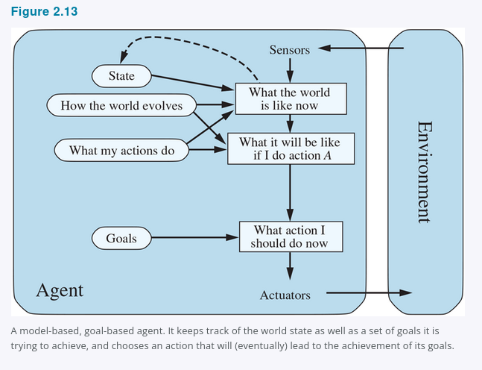
2.4.4 Goal-Based Agents
2.4.4
A current state is not enough; the agent also needs a goal.
Search / planning
Find action sequences that achieve goals. This transitions to Chapters 3-5.
Flexibility
Change the destination, and the same knowledge can support new behavior.
Cost
The agent may need to reason about many possible future action sequences.
Figure 2.13
COMP 469 · Chapter 2
34
Notes:
SLIDE 35 · 2.4.4 Goal-Based Agents
Suggested time: 6 minutes · Running total: 156 min · Chapter alignment: Section 2.4.4 and Figure 2.13
TRANSITION
The planning video makes the difference between reaction and look-ahead behavior visible.
SOURCES
AIMA 4e, Section 2.4.4 and Figure 2.13.

Slide 36
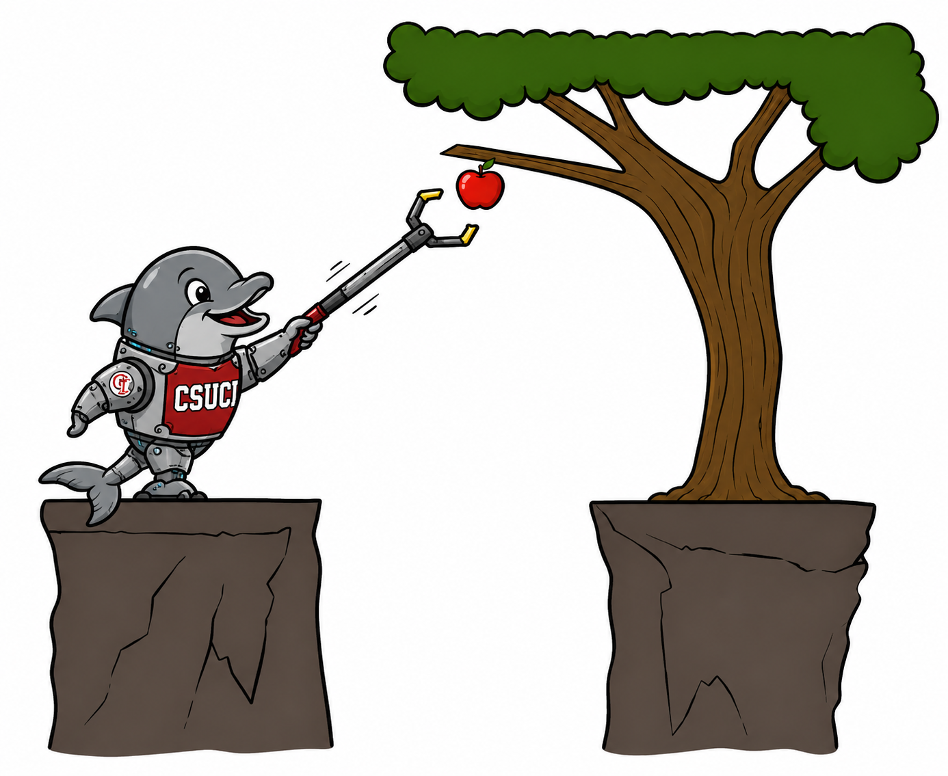
Planning Video Bridge: Reflex vs. Planning
Bridge
Reflex agent
Chooses an action from the current percept, or from internal state in the model-based case; does not consider future consequences.
Planning agent
Asks “what if?” and chooses actions based on predicted consequences. Must model how the world evolves and must formulate a goal test.
Replanning Pac-Man
Plans a little way ahead, acts, then replans from the new state. This is different from planning once and executing forever.
Key distinction: planning considers how the world WOULD BE, not just how it is now.
Planning distinctions
Optimal vs. complete planning compares best solution quality vs. guaranteed solution finding. Planning vs. replanning compares one long plan vs. repeated look-ahead as the state changes.
COMP 469 · Chapter 2
35
Notes:
SLIDE 36 · Planning Video Bridge: Reflex vs. Planning
Suggested time: 7 minutes · Running total: 163 min · Chapter alignment: Goal-based agents and transition to search
TRANSITION
Goals tell the agent what counts as success, but they do not rank multiple successful outcomes. Utility provides that ranking.
SOURCES
Planning video transcript, approximately 1:19-10:05.
AIMA Chapter 2, Section 2.4.4.

Slide 37
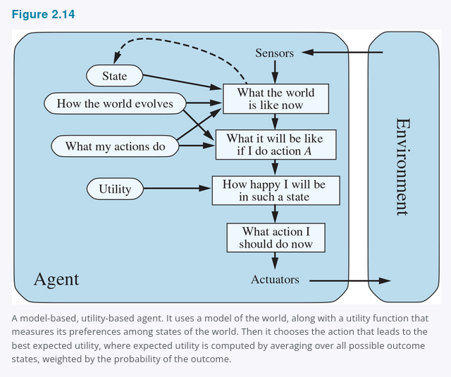
2.4.5 Utility-Based Agents
2.4.5
Goals say whether a state is acceptable; utility ranks how good it is.
Goal-based
Destination reached?
Yes or no.
Utility-based
How good is each outcome?
Fast, safe, comfortable, cheap?
Expected utility
Weigh utility by probability when outcomes are uncertain.
Utility handles conflicts and uncertainty.
Figure 2.14
COMP 469 · Chapter 2
36
Notes:
SLIDE 37 · 2.4.5 Utility-Based Agents
Suggested time: 6 minutes · Running total: 169 min · Chapter alignment: Section 2.4.5 and Figure 2.14
TRANSITION
The next slide focuses on the two main reasons utility is more expressive than goals: tradeoffs and uncertainty.
SOURCES
AIMA 4e, Section 2.4.5 and Figure 2.14.

Slide 38
Utility Handles Tradeoffs and Uncertainty
2.4.5
Conflicting goals
Uncertain goals
Expected utility
Speed and safety can conflict. Utility specifies the tradeoff.
Several outcomes may be possible, none guaranteed.
Likelihood of success is weighed against outcome importance. Any rational agent behaves as if it maximizes expected utility, explicitly or not.
Utility function = internalization of the performance measure
If the internal utility function and external performance measure agree, maximizing utility supports rational behavior.
Caution: if the utility function is wrong, the agent may optimize the wrong objective.
COMP 469 · Chapter 2
37
Notes:
SLIDE 38 · Utility Handles Tradeoffs and Uncertainty
Suggested time: 5 minutes · Running total: 174 min · Chapter alignment: Section 2.4.5
TRANSITION
So far, every design assumes that the agent's rules, models, goals, or utility already exist. Learning explains how those components can improve.
SOURCES
AIMA 4e, Section 2.4.5.

Slide 39
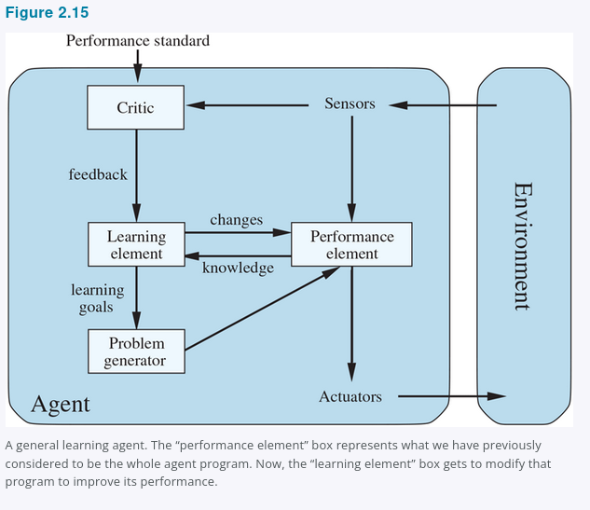
2.4.6 Learning Agents
2.4.6
Any agent type can be made into a learning agent.
Performance element
Selects external actions.
Learning element
Improves the performance element.
Critic
Evaluates behavior against a fixed performance standard.
Problem generator
Suggests exploratory actions for informative experience.
Figure 2.15
COMP 469 · Chapter 2
38
Notes:
SLIDE 39 · 2.4.6 Learning Agents
Suggested time: 7 minutes · Running total: 181 min · Chapter alignment: Section 2.4.6 and Figure 2.15
TRANSITION
The next slide asks exactly which internal components a learning process can modify.
SOURCES
AIMA 4e, Section 2.4.6 and Figure 2.15.

Slide 40
Learning Agent Components: What Improves?
2.4.6
Performance element
Transition model
Sensor model
What action should I do now?
What do my actions do?
What percepts should I expect?
Utility / rules
Problem generator
What outcomes should I prefer?
What should I explore next?
Learning modifies agent components to better match feedback and improve performance.
COMP 469 · Chapter 2
39
Notes:
SLIDE 40 · Learning Agent Components: What Improves?
Suggested time: 6 minutes · Running total: 187 min · Chapter alignment: Section 2.4.6
TRANSITION
Learning and reasoning both depend on how the agent represents states, attributes, objects, and relationships.
SOURCES
AIMA 4e, Section 2.4.6.

Slide 41
2.4.6 Turing's Bet and the Fixed Standard
2.4.6
Turing's proposal (1950)
Turing considered programming intelligent machines by hand, estimated the work involved, and concluded that “some more expeditious method seems desirable.” His alternative: build machines that learn, then teach them.
The critic must be fixed
Galileo as problem generator
Feedback reshapes what it wants
Percepts do not announce success. A chess program can perceive that it has checkmated its opponent and still need a standard to know that this is good news. Think of the performance standard as sitting outside the agent — because the agent must not be able to edit it to fit its own behavior.
Dropping rocks from a tower in Pisa was not valuable in itself. Galileo was not trying to break the rocks. He was running an experiment to improve his own theory. The problem generator proposes actions that are suboptimal now and informative later.
Passengers shaken up on the trip leave no tip. Pedestrians cover their ears — and occasionally cut the wires — when the taxi sounds its horn continuously. Both are evidence the agent can use to revise its utility function.
Learning = pulling every component into closer agreement with the feedback
Improving a model so it matches reality is almost always worth doing on its own terms. Improving a reflex rule or a utility function is not — that needs information from the external standard. Hard-wired standards such as pain and hunger in animals play exactly this role.
COMP 469 · Chapter 2
40
Notes:
SLIDE 41 · 2.4.6 Turing's Bet and the Fixed Standard
Suggested time: 5 minutes · Running total: 192 min · Chapter alignment: Section 2.4.6
We have the four components of a learning agent. This slide is about why three of them are shaped the way they are.
Start with Turing, because it frames the whole enterprise. In his 1950 paper he seriously considered hand-programming an intelligent machine, estimated how much labour that would take, and concluded that some more expeditious method seemed desirable. His proposal was to build machines that learn and then teach them. That is now the preferred route to state-of-the-art systems across most of AI, and it is worth telling students that the idea is more than seventy-five years old.
Now the critic, and this is the conceptually important one. The critic tells the learning element how well the agent is doing against a performance standard, and the standard has to be fixed. Why? Because percepts by themselves carry no verdict. A chess program can receive a percept indicating that it has checkmated its opponent; nothing in that percept says checkmating is good. The standard supplies that. And it must sit conceptually outside the agent, because an agent that could modify its own standard could always succeed by lowering the bar. When students later meet reward hacking, this is the slide to point back to.
The problem generator gets Galileo. Dropping rocks from the tower at Pisa had no value in itself — he was not trying to break the rocks, and he was certainly not trying to modify the brains of any pedestrians below. He was trying to modify his own brain by getting a better theory of motion. That is exactly the problem generator's job: propose actions that look suboptimal by current knowledge because they will produce informative experience. If the performance element always got its way, the agent would keep doing whatever is currently best and never discover anything better.
The third card is about where information for learning comes from. The taxi that shakes its passengers up receives no tips, and the external standard has to tell it that lost tips are a negative contribution, at which point it can learn that violent manoeuvres do not serve it. The taxi that sounds its horn continuously to warn pedestrians observes people covering their ears, using bad language, and occasionally cutting the wires to the horn — human behaviour that is evidence about human preferences. In this sense the performance standard singles out part of the incoming percept as reward or penalty. Pain and hunger in animals are hard-wired versions of the same mechanism.
One asymmetry to close on, on the bottom line: improving the model components so they match reality is almost always a good idea regardless of the external standard. Improving a reflex rule or a utility function is not — that specifically requires information from the standard, because there is no other way to know which behaviour was better.
TRANSITION
That covers how components improve. The last question is how they represent the world in the first place.
SOURCES
AIMA 4e, Section 2.4.6; Turing (1950).

Slide 42
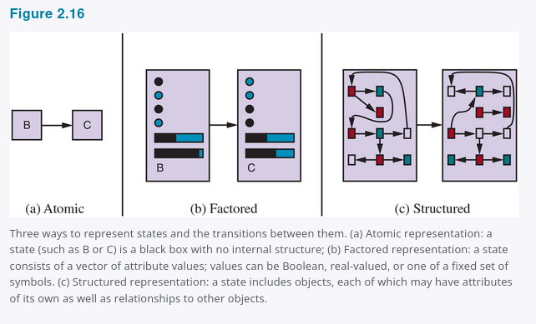
2.4.7 Representing the World Inside the Agent
2.4.7
Atomic
Factored
Structured
State is a set of variables.
Example: location, fuel, speed, weather.
Used in Constrain Satisfaction Problems, logic, Bayes nets, planning.
Objects plus relations.
Example: truck blocking cow near driveway.
Used in first-order logic, databases, language.
State is a black box.
Example: city name only.
Used in search, games, Hidden Markov Model, Markov Decision Process.
less expressive, easier reasoning
more expressive, harder reasoning
Design choice: enough expressive power for the task, but not more than the agent can reason with efficiently.
Figure 2.16
COMP 469 · Chapter 2
41
Notes:
SLIDE 42 · 2.4.7 Representing the World Inside the Agent
Suggested time: 7 minutes · Running total: 199 min · Chapter alignment: Section 2.4.7 and Figure 2.16
TRANSITION
We can now compare all of the agent program designs in one view.
SOURCES
AIMA 4e, Section 2.4.7 and Figure 2.16.

Slide 43
2.4.7 Expressiveness Has a Price
2.4.7
How many pages does it take to write down the rules of chess?
Atomic
Factored
Structured
≈ 10³⁸
thousands
1–2
pages, written in a language of finite-state automata
of pages, written in propositional logic
pages, written in first-order logic
The same content, expressed more concisely — and reasoned over more slowly
Choosing a point on the axis
A more expressive representation captures everything a less expressive one can, at least as concisely, plus more — but reasoning and learning get harder as expressive power rises. Intelligent systems for the real world may need to operate at every point on the axis at once.
Rule of thumb: take the least expressive representation that still captures what the task requires.
COMP 469 · Chapter 2
42
Notes:
SLIDE 43 · 2.4.7 Expressiveness Has a Price
Suggested time: 3 minutes · Running total: 202 min · Chapter alignment: Section 2.4.7
TRANSITION
There is a second, independent representation axis that the chapter mentions only briefly and that turns out to matter enormously.
SOURCES
AIMA 4e, Section 2.4.7.

Slide 44
2.4.7 Localist and Distributed Representations
2.4.7
A second axis: how do concepts map onto locations in memory — or in a brain?
Localist
Distributed
One concept, one memory location, and the mapping between them is arbitrary. Garble a few bits in transmission and Truck can become the entirely unrelated concept Truce.
Each concept is spread across many locations, and each location contributes to many concepts. A concept becomes a point in a multidimensional space.
Truck
Truce
one concept, spread across every cell
Two cells apart in memory, two meanings with nothing in common.
Garble a few bits and you move to a nearby point, which carries a similar meaning.
Distributed representations are more robust to noise and information loss
This axis is independent of atomic, factored, and structured — it asks where the information physically lives rather than how much it can express. It is also the bridge from Chapter 2 to the learned vector representations behind modern neural systems (Chapter 21).
COMP 469 · Chapter 2
43
Notes:
SLIDE 44 · 2.4.7 Localist and Distributed Representations
Suggested time: 3 minutes · Running total: 205 min · Chapter alignment: Section 2.4.7
TRANSITION
That completes the chapter's technical content. Before the summary, it is worth seeing where these ideas came from.
SOURCES
AIMA 4e, Section 2.4.7.

Slide 45
All Agent Program Designs in Chapter 2
Synthesis
Table-driven
Simple reflex
Model-based reflex
Stores percept history and looks up an action in a table.
Maps current percept to action using condition-action rules.
Maintains internal state using transition and sensor models.
Goal-based
Utility-based
Learning
Chooses actions by reasoning toward goals.
Ranks outcomes and maximizes expected utility.
Improves components from feedback and experience.
These are design patterns, not rigid boxes. Real systems combine them, and not every utility-based agent needs a model of the world.
COMP 469 · Chapter 2
44
Notes:
SLIDE 45 · All Agent Program Designs in Chapter 2
Suggested time: 5 minutes · Running total: 210 min · Chapter alignment: Synthesis of Sections 2.4.1-2.4.6
TRANSITION
The environment properties tell us which of these design capabilities are necessary.
SOURCES
AIMA 4e, Sections 2.4.1-2.4.6.

Slide 46
Choosing an Agent Design from Environment Properties
Synthesis
Fully observable + short horizon
Partially observable
Simple reflex
Fast condition-action rules may be enough.
Model-based reflex
Maintain internal state and update it using models.
Long-term objective
Tradeoffs / uncertainty
Goal-based
Search or planning over future action sequences.
Utility-based
Compare outcomes by expected utility.
Unknown rules / changing world
Learning agent
Improve model, utility, rules, or policy from feedback.
COMP 469 · Chapter 2
45
Notes:
SLIDE 46 · Choosing an Agent Design from Environment Properties
Suggested time: 6 minutes · Running total: 216 min · Chapter alignment: Synthesis of Sections 2.3 and 2.4
TRANSITION
The PEAS activity lets students apply this workflow before proposing an algorithm.
SOURCES
AIMA 4e, Sections 2.3 and 2.4.

Slide 47
Class Activity: Build a PEAS Description
Activity
Choose one system, then fill in PEAS before proposing an algorithm.
Autonomous Pac-Man
Campus chatbot
Email phishing triage agent
Robotic delivery cart
Performance
Environment
Write 2-3 concrete items.
Write 2-3 concrete items.
Actuators
Sensors
Write 2-3 concrete items.
Write 2-3 concrete items.
Checkpoint: if you cannot fill in PEAS, you are not ready to choose an algorithm.
COMP 469 · Chapter 2
46
Notes:
SLIDE 47 · Class Activity: Build a PEAS Description
Suggested time: 12 minutes · Running total: 228 min · Chapter alignment: Applied Section 2.3.1
TRANSITION
We will now apply the same vocabulary to the autonomous Pac-Man program used in the class demonstration.
SOURCES
AIMA 4e, Section 2.3.1; lecture deck activity.

Slide 48
Class Demo: Autonomous Pac-Man Agent
Demo
Use the game to make the Chapter 2 vocabulary concrete.
What are the percepts?
What actions can the agent return?
What is the performance measure?
Does it use memory or only current state?
Is it reflex, model-based, goal-based, utility-based, or mixed?
Next: search algorithms are one way to make goal-based agents act rationally.
COMP 469 · Chapter 2
47
Notes:
SLIDE 48 · Class Demo: Autonomous Pac-Man Agent
Suggested time: 10 minutes · Running total: 238 min · Chapter alignment: Applied Sections 2.1-2.4.6
TRANSITION
Next, we will connect the live Pac-Man behavior to the specific Python agent files that implement the Chapter 2 agent designs.
SOURCES
AIMA 4e, Sections 2.1-2.4.6; autonomous Pac-Man classroom code.

Slide 49
Live Code Demo: Five Chapter 2 Agent Programs
Demo code
The graphics and environment stay fixed; only the agent program changes.
Shared environment / architecture: pacman_chapter2_engine.py — sensors, actuators, maze, ghosts, scoring, graphics, and performance feedback
Simple Reflex 01_simple_reflex_agent_ch2.py
Model-Based Reflex 02_model_based_reflex_agent_ch2.py
current percept + ordered if-then rules
internal state + transition_model + sensor_model
Goal-Based 03_goal_based_agent_ch2.py
Utility-Based 04_utility_based_agent_ch2.py
formulate_goal + make_plan + execute first action
expected_utility over each legal action
Learning 05_learning_agent_ch2.py
performance element + critic + learning + problem generator
Run order: 1 → 2 → 3 → 4 → 5. After each one, ask what changed in the decision process.
Code focus: the section marked CHAPTER 2 AGENT PROGRAM STARTS HERE.
COMP 469 · Chapter 2
48
Notes:
SLIDE 49 · Live Code Demo: Five Chapter 2 Agent Programs
Suggested time: 10 minutes · Running total: 248 min · Chapter alignment: Live demonstration files; Section 2.4 agent program
TRANSITION
After the code demonstration, we will return to the planning video boundary and separate Chapter 2 concepts from Chapter 3 algorithms.
SOURCES
Uploaded files: pacman_chapter2_engine.py and 01-05 *_agent_ch2.py.
AIMA Chapter 2, Sections 2.4.1-2.4.6.

Slide 50
How the Planning Video Fits This Chapter
Video
Watch now for Chapter 2
Comes back in Chapter 3
1:19-10:05: agents that plan, reflex agents, Pac-Man examples, planning versus replanning.
After ~11:48: search problem formulation, state spaces, search trees, DFS, BFS, UCS.
Chapter boundary
Chapter 2 explains what a goal-based agent is. Chapter 3 explains how search implements it.
We watch the first segment as a bridge, then stop before the full search algorithms.
COMP 469 · Chapter 2
49
Notes:
SLIDE 50 · How the Planning Video Fits This Chapter
Suggested time: 2 minutes · Running total: 250 min · Chapter alignment: Chapter boundary and course sequencing
TRANSITION
We will close by compressing the chapter into a small set of design rules.
SOURCES
Planning video transcript, approximately 1:19 onward.
AIMA 4e, Section 2.4.4.

Slide 51
Where These Ideas Came From
History
Aristotle
Turing
McCarthy
Samuel
Nicomachean Ethics
1950
1958
1959, 1967
Practical reasoning — action at the center of intelligence.
Hand-programming is too slow; build machines that learn and teach them.
“Programs with Common Sense” — the logical, goal-directed line of AI.
A checkers program that improves with play: the learning-agent design, working.
Fikes & Nilsson
Doyle
Pearl
Control theory
1971
1983
1988
throughout
Shakey — the first robot embodiment of a logical, goal-based agent.
Predicted that rational agent design would become the core mission of AI.
Probability and utility in depth; the shift toward utility-based agents.
A controller is an agent; its subfields map onto our environment dimensions.
AI spent decades on isolated components; the whole-agent view is now the default
Question-answering systems, theorem provers, and vision systems were studied largely in isolation. Genesereth and Nilsson (1987) were an influential exception, and the agent-based approach now runs through software engineering, operating systems, and the AAMAS conference series.
COMP 469 · Chapter 2
50
Notes:
SLIDE 51 · Where These Ideas Came From
Suggested time: 3 minutes · Running total: 253 min · Chapter alignment: Bibliographical and Historical Notes
TRANSITION
That is the chapter. Let us collect the points you should be able to use.
SOURCES
AIMA 4e, Chapter 2, Bibliographical and Historical Notes.

Slide 52
Chapter 2 Takeaways
Summary
An agent perceives an environment through sensors and acts through actuators.
A rational agent maximizes expected performance, not hindsight perfection.
PEAS specifies the task: performance, environment, actuators, sensors.
Environment properties determine which agent design is appropriate.
Agent programs include table-driven, simple reflex, model-based, goal-based, utility-based, and learning agents.
Representations determine what the agent can express and how hard reasoning becomes.
Define the agent -> Specify the task -> Classify the environment -> Choose the design
COMP 469 · Chapter 2
51
Notes:
SLIDE 52 · Chapter 2 Takeaways
Suggested time: 4 minutes · Running total: 257 min · Chapter alignment: Chapter summary
SOURCES
AIMA 4e, Chapter 2 summary.

